Slide 1
Potential for thermal IR detection of dust plume from DART impact on Didymos
Simon F. Green,
Colin Snodgrass, Ben Rozitis
Planetary and Space Sciences
The Open University
Milton Keynes, UK.
Didymos Observer Workshop, Prague 19-21 June 2018

Slide 2
Observation opportunities
3
2
1
𝚫
r
Didymos detectable in thermal IR for V ≲18.5
(July 2023 – Jan 2023)
160°
120°
80°
40°
Elongation
Encounter date when Didymos is close to maximum brightness
(best opportunity for
plume detection)
Phase angle
14
16
18
20
22
V magnitude
Feb 1
Apr 1
Jun 1
Aug 1
Oct 1
Dec 1
Feb 1
Apr 1
Jun 1
2022
2023
Didymos Observer Workshop, Prague Plume detectability 19-21 June 2018

Slide 3
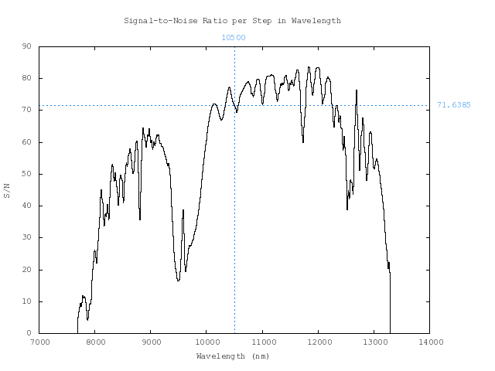
IR observation opportunties
Didymos photometry and spectroscopy (5 Oct 2022)
Example with VLT VISIR
F ~ 1.1 Jy at λ = 10.7 μm
Photometry
B10.7 filter
S/N=100
in 8 s exposure
Spectroscopy
- LowRes
- 600 s exposure
- (Assume 300 K
black-body
with Didymos flux)
80
60
40
S/N
20
7 8 9 10 11 12 13 λ/μm
Didymos Observer Workshop, Prague Plume detectability 19-21 June 2018

Slide 4

Ground-based Thermal IR Facilities
Subaru 8m: COMICS 7.5-25 μm (I+S),
IRCS 0.9-5.6 μm (S)
Keck 10 m: NIRC2 →5 μm (I+S)
Gemini N 8m: ??
IRTF 3m: MIRSI/MOC 5-20 μm (I+S),
SpeX & iSHELL →5.3 μm (S)
LBT 2 x 8.4 m:
NOMIC 8-13 μm (I) ??
LMIRCam 1-5 μm
VLT 8m:
VISIR 8-25 μm (I+S)
Ignore day/night division, which is still TBD
6-10m 3-5 m with IR capability no IR capability
Didymos Observer Workshop, Prague Plume detectability 19-21 June 2018

Slide 5

Geometry
Inconsistent information – is this correct?
Impact point visible from Earth
Plume particles move towards Earth
29.5°
60.1°
65.7°
r = 1.028 AU
DART
Δ = 0.0721 AU
Didymos Observer Workshop, Prague Plume detectability 19-21 June 2018

Slide 6
Simple ejecta plume model
Very simple ejecta plume assumptions…
Applies only to first few minutes after impact
v_{max}
Particles uniformly
distributed in plume
Particle size range
between D_{min} and D_{max}
Volume of ejecta = f π D_{c}³/12
f is scaling factor
(fraction of crater volume
ejected as particulates)
v_{min}
Conical plume
subtends half angle θ
D_{c}
Didymos Observer Workshop, Prague Plume detectability 19-21 June 2018

Slide 7
Simple ejecta plume model
Assign best estimates of: D_{c}, f, θ Size distribution, v_{max}, v_{min}
Assume cloud is optically thin (initially unlikely)
Assume particles are isothermal, isotropic grey-body emitters
Assume plume is pointing directly at observer
Assume surface brightness is evenly distributed throughout projected plume cross-section
IR imaging throughout impact period
Exposure times are << 1 second
Combine data to set effective exposure time of t/2
Use default conditions for calculation of S/N for telescope/instrument
(Usually optimistic!)
Didymos Observer Workshop, Prague Plume detectability 19-21 June 2018

Slide 8
Particle size distribution
Assume power law with small particle cut-off:
N(>D) = k [(D^{b})+(D_{o}^{b})]^{-s/b}
s = cumulative size distribution index, D_{o} = turnover diameter
b determines sharpness of small particle cut-off
k = scaling factor (scale to total ejecta volume)
s = 3.1, b = 3
D_{o} = 30 μm
s = 5, b = 1
D_{o} = 300 μm
Didymos Observer Workshop, Prague Plume detectability 19-21 June 2018

Slide 9
Grain temperature
Assume particles are isothermal, isotropic grey-body emitters
Assume thermal inertia = 150 J m⁻² K⁻¹ s^{-1/2} (mean of NEA binaries)
Assume thermal inertia of Didymoon is the same.
Diurnal and seasonal thermal skin depth for Didymoon = 0.4 and 17 cm
Most of crater volume is initially at orbital mean temperature ~ 250 K
Blackbody equilibrium temperature at encounter = 275 K
Heating time t(250→275 K) ~ 6100 (D_{p}/metres) seconds
For D_{c} = 100 μm, t = 37 s For D_{c} = 10 cm t ~ 10 h
Signal dominated by small particles, so assume at equilibrium T
NB as observed for comets.
dust particles with D_{c} ≲ 10 μm are superheated
Didymos Observer Workshop, Prague Plume detectability 19-21 June 2018

Slide 10
Default parameters
Conservative choice of default values
Property Minimum Default Maximum
Crater diameter, D_{c} 6 m 8 m 17 m
Fraction ejected, f 0.1? 0.2 <1
Ejecta cone, θ ~5°? 45° 90°
Minimum speed, V_{min} 0.01 m s⁻¹ 10 m s⁻¹ ?
Maximum speed, V_{min} ? 1000 m s⁻¹ ?
Turnover diameter, D_{o} ? 30 μm ?
Size distribution index, s ? 3.1 ?
Size index derating factor, b ? 3 ?
Minimum particle size, D_{min} ? 1 μm ~30 μm?
Maximum particle size, D_{max} ? 10 cm ~1 m?
Didymos Observer Workshop, Prague Plume detectability 19-21 June 2018

Slide 11
Plume detectability
Results for 8m VLT VISIR imaging. Integration = t/2
Default parameters
Didymos Observer Workshop, Prague Plume detectability 19-21 June 2018

Slide 12
Sensitivity to parameters
Crater diameter
S/N ∝ D_{c}³
Fraction ejected
S/N ∝ f
Didymos Observer Workshop, Prague Plume detectability 19-21 June 2018

Slide 13
Sensitivity to parameters
Cone angle θ
Narrower cone angles increase S/N
- cone is unresolved for longer
- surface brightness increased
Turnover diameter D_{o}
Smaller D_{o} increases S/N
- more scattering area in
small particles
Didymos Observer Workshop, Prague Plume detectability 19-21 June 2018

Slide 14
Sensitivity to parameters
Size distribution index, s
Higher s increases S/N
- more scattering area in small
particles
Size index derating factor, b
Lower b increases S/N
- more small particles
- More important if D_{o} is large
and/or if s is large
Didymos Observer Workshop, Prague Plume detectability 19-21 June 2018

Slide 15
Sensitivity to parameters
Maximum ejecta speed V_{max}
Slower speeds increase S/N
- longer dwell time in
unresolved regime
V_{min} has negligible effect because of geometry and model assumptions
Relative importance of each parameter can depend critically on values of other parameters
Parameters unlikely to be independent
Didymos Observer Workshop, Prague Plume detectability 19-21 June 2018

Slide 16
Other possibilities: SOFIA
2.7 m Airborne IR telescope
FORCAST:
5–40 μm camera/spectrograph
Simultaneous imaging
in 2 channels:
SWC < 25 μm < LWC
Observation cycle 7
(April 2019 – April 2020).
If operating in 2022 need proposals ~1 year in advance.
Estimated S/N = 3.3 in 30s integration for default parameters.
Didymos Observer Workshop, Prague Plume detectability 19-21 June 2018

Slide 17
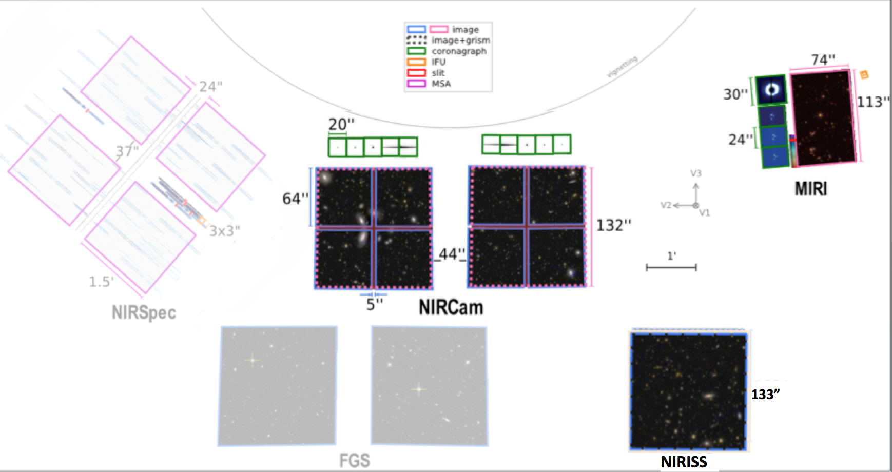
Other possibilities: JWST
6.5 m IR space telescope
Will it be operational by 2022?
Within solar elongation constraints (85°-135°) – 102° at impact
Didymos motion (436 ”/hr = 121 mas/s) beyond JWST limit 30 mas/s
- If tracking at max rate, Didymos crosses field in:
MIRI (5–28 μm): 811–1240 s; NIRCam (0.6–5 μm): : 1448–3380 s
Didymos Observer Workshop, Prague Plume detectability 19-21 June 2018

Slide 18
Conclusions
Ground-based thermal IR observations of plume:
Appear to be feasible (for conservative model parameters)
Nominal values close to limit for 10m-class telescopes
- fraction of Didymos emission
Strong dependence of signal on choice of model parameters
- ejecta volume
- grain size distribution
Parameters not independent
- ejection speeds, plume angle, dependent on size?
Actual plume structure will not be uniform
- local S/N increased when plume is resolved
Didymos Observer Workshop, Prague Plume detectability 19-21 June 2018

