Slide 1
Planning for 2022: lessons learned from the Rosetta 67P observing campaign
Colin Snodgrass

Slide 2
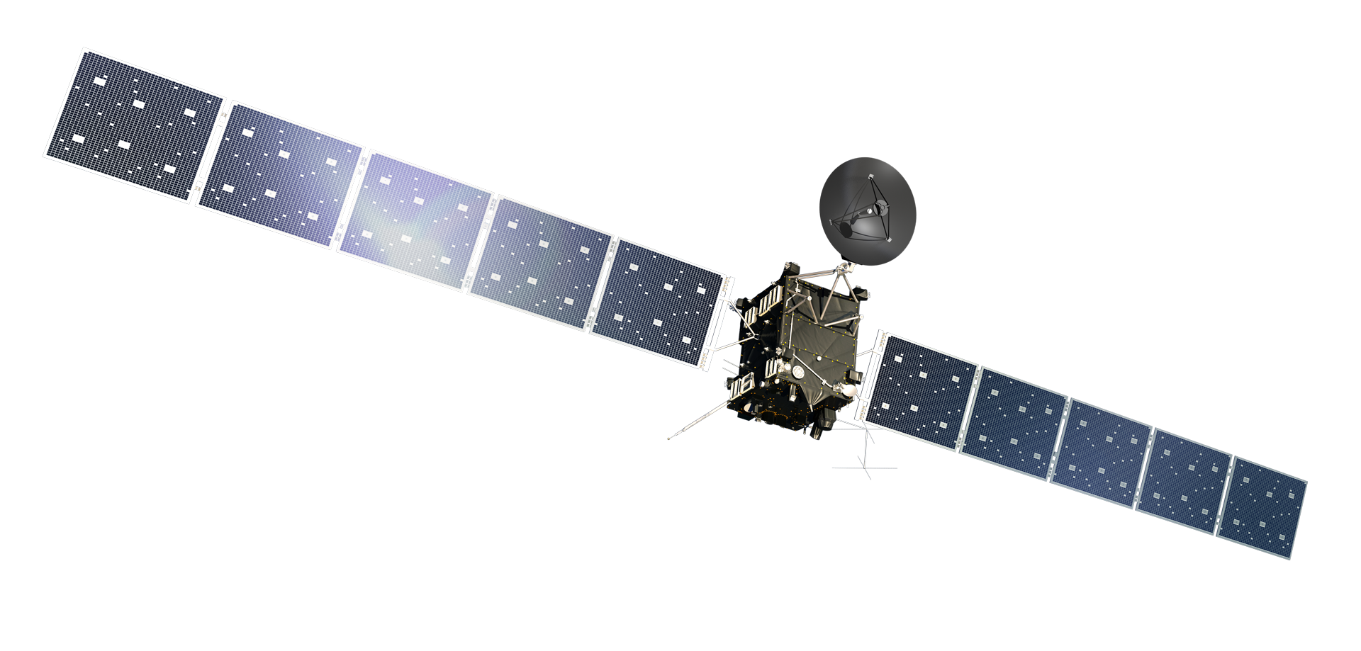
Ground based support to Rosetta
Rosetta operates within a tiny region of the inner coma
Nearly every other comet we will ever study will be from the ground
The way to match the resolution of Rosetta results with other comets is by linking them to ground observations
You are here
820,000 km

Slide 3
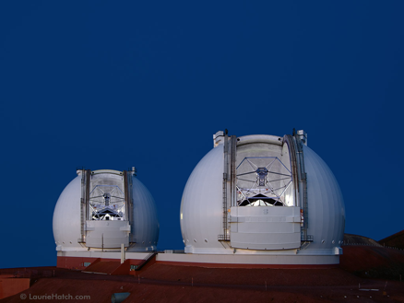
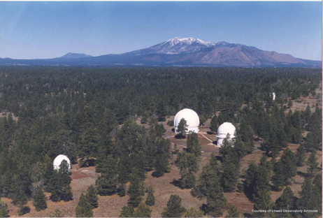
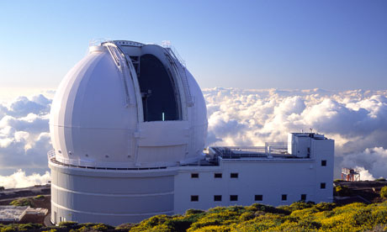
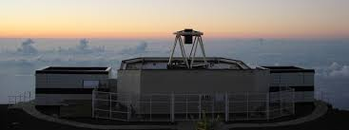
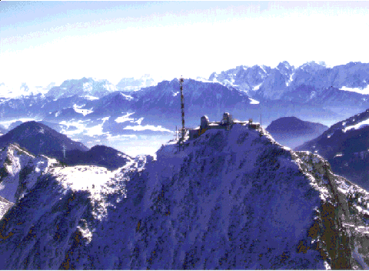
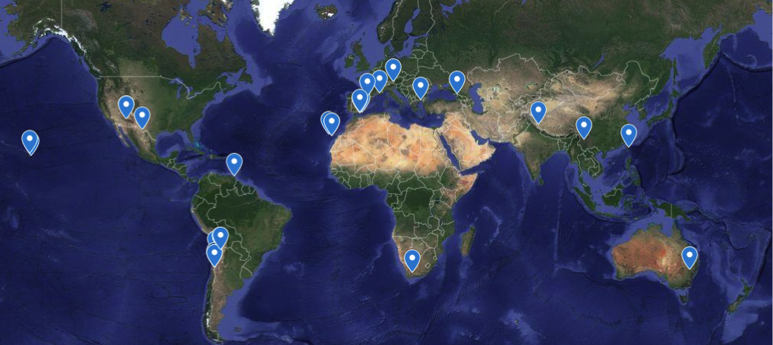
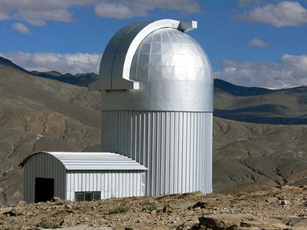
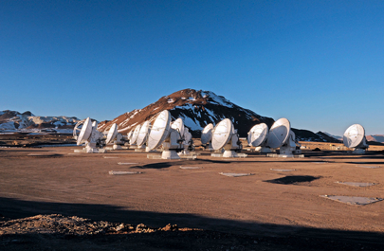
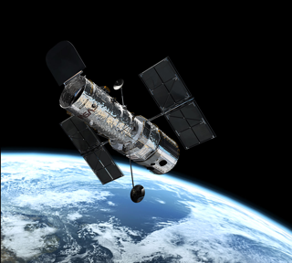
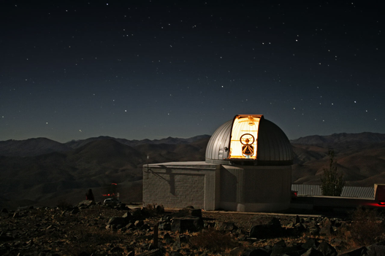
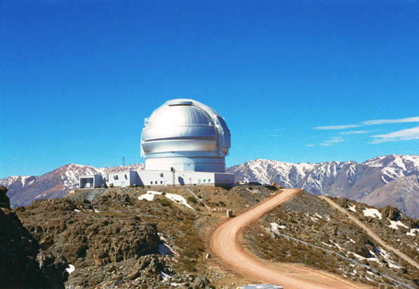
2013-2016
44 different telescopes
UV-radio
1300 hours on target
+ amateur obs.
Snodgrass et al. 2017,
Phil. Trans. Royal Soc. A. 375, id.20160249
http://www.rosetta-campaign.net/
Notes:
> 700 observation nights listed so far

Slide 4
Parallel observations
Observations were critical during Rosetta active phase for direct comparison
Required regular monitoring of
Total brightness ( = dust production rate)
Gas production rates
Coma morphology (link to jets from nucleus)
Dust / gas properties on large scale
Astrometry (non-gravitational forces)

Slide 5
Total activity measures

Slide 6
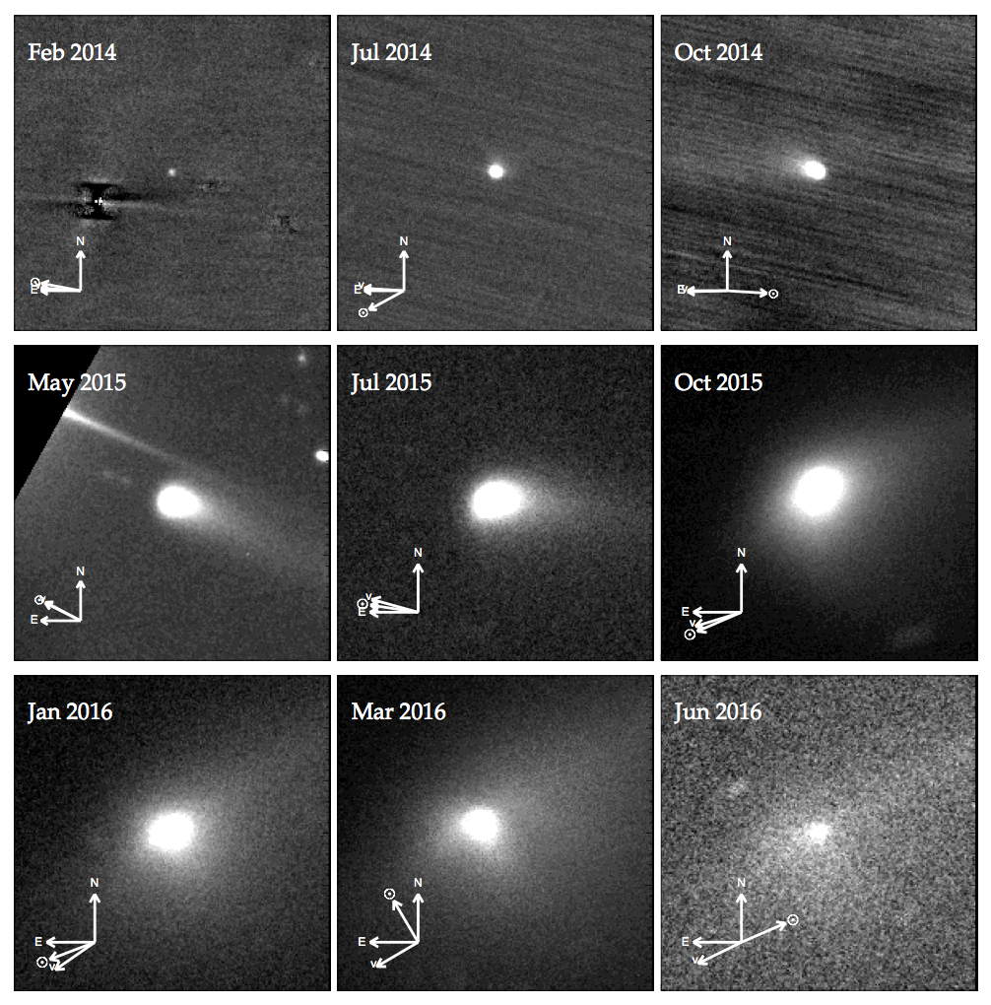
Changing morphology
1’ FOV centred on comet

Slide 7
Spectroscopy
WHT/ISIS, Aug 2015
Fitzsimmons et al

Slide 8
Observations
2013 – VLT monitoring
2014, Feb – Nov
VLT, NOT, Gemini
Vis imaging + spec, NIR imaging (end of period)
Snodgrass et al 2016, A&A in press
2015, May-Jul VLT
Vis imaging + spec
2015, Aug onwards
Just observable from Northern hemisphere
VLT again from November
2015/16
Best visibility period
Canary Islands ITP – 6 telescopes
VLT + Gemini
TRAPPIST, Lowell
NOT, Wendelstein, Pic du Midi, Rohzen, Calar Alto, Sierra Nevada, SAO 6m
Keck, IRTF
LCOGT
France+India pol campaign
HST, Spitzer, Odin, Kepler
ALMA, IRAM, ARO
+ amateur observations throughout

Slide 9
Rosetta campaign set up
Run by observers, with link to ESA. Not formally an ESA campaign (formally ESA doesn’t do ground based obs). [different for Hera?]
1st meeting, London, April 2012
2nd meeting, Garching (Munich), July 2013
3rd meeting, Denver, October 2013 (DPS)
Website set up:
www.rosetta-campaign.net
Mailing list associated with this
https://groups.google.com/group/rosetta-obs
Intended for communication between pro observers

Slide 10
1st meeting
We met in London (UCL) on 17+18 April 2012, funded by Europlanet NA1
37 Attendees, talks on a range of facilities and science topics.
3 panel discussions on what can be achieved
At ESO
Using Northern facilities
By amateurs
Included significant outreach and amateur astronomer contributions
Goal was to come up with a coordinated campaign, or roadmap towards one.

Slide 11
2nd meeting
Met at ESO HQ in Garching, 9+10th July 2013
More detailed discussion on what was expected from the comet, what we would like to do, what facilities are available (ESO + elsewhere)
Presentations from Rosetta instrument teams (OSIRIS, VIRTIS, MIRO) on required ground-based support
Discussion on what “ground driven” science we would do
Created a “wish list” of observations, assigned people/facilities where possible
Agreed to set up mailing list & website

Slide 12
Other meetings
3rd at DPS.
Shorter meeting (2 hours instead of 2 days)
Presentation from Karen Meech on previous NASA mission support campaigns (DI/EPOXI)
Significant discussion on amateur contribution to campaign (lessons from DI/EPOXI/ISON)
Meetings during campaign
at Rosetta SWT meetings (splinter sessions),
Approx every 6 months, varied in size/length
Dedicated observer meeting in Seggau in June 2016 (end of campaign) – Europlanet NA1 funded

Slide 13
Coordination / communications
Single coordinator responsible for most comms
Role assigned by ESA project
Support from ESA project scientist where necessary
Many individual PIs on proposals, but effort to coordinate these
Communication primarily through mailing list
Reasonably frequent telecons, especially before proposal deadlines etc.
+ a few face-to-face meetings

Slide 14
Mailing list / Website
Google site and Google groups solution, as free and very simple to use – www.rosetta-campaign.net
Mailing list membership also gives access to ‘team only’ parts of website
Mailing list for communication between pro (and some advanced amateur) observers
Can only post to list as member
Mostly used for broadcast from coordinator
Anyone can apply, membership moderated

Slide 15
Website
Attempted to collect useful information in one place
Quick look ephemeris
Visibility plots, finder charts
Observing plans
Observation log
Simple forms to add information
Tables & calendars to display it
Google site & google mailing list for simple interaction (single log in)

Slide 16
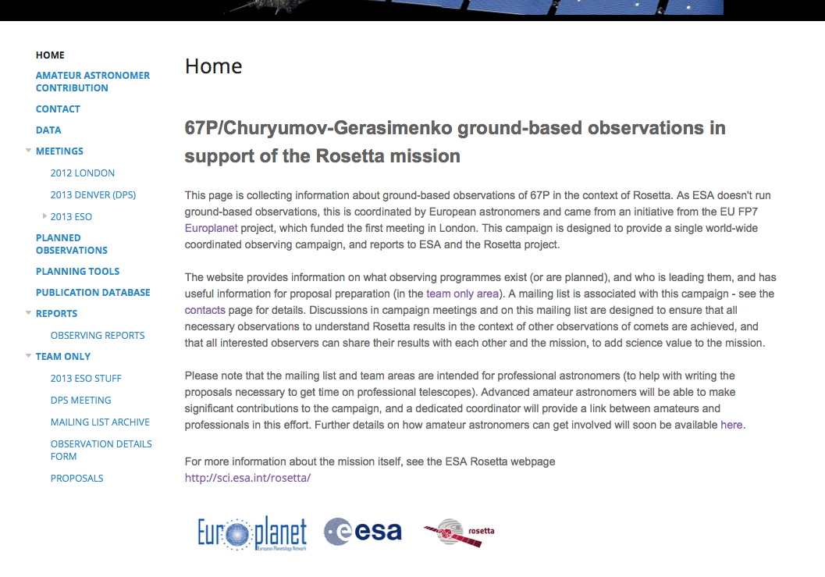

Slide 17
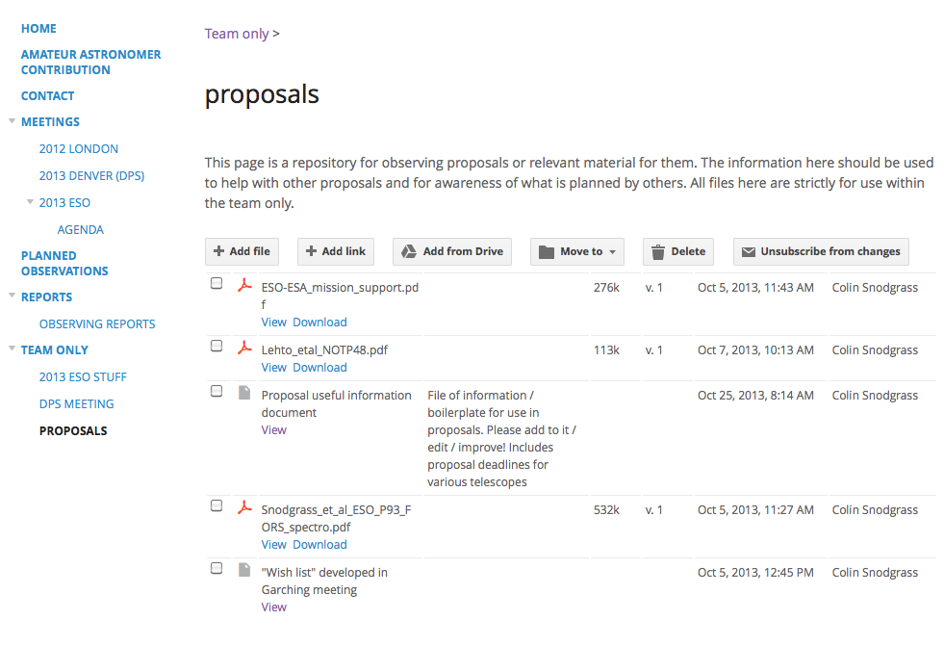

Slide 18
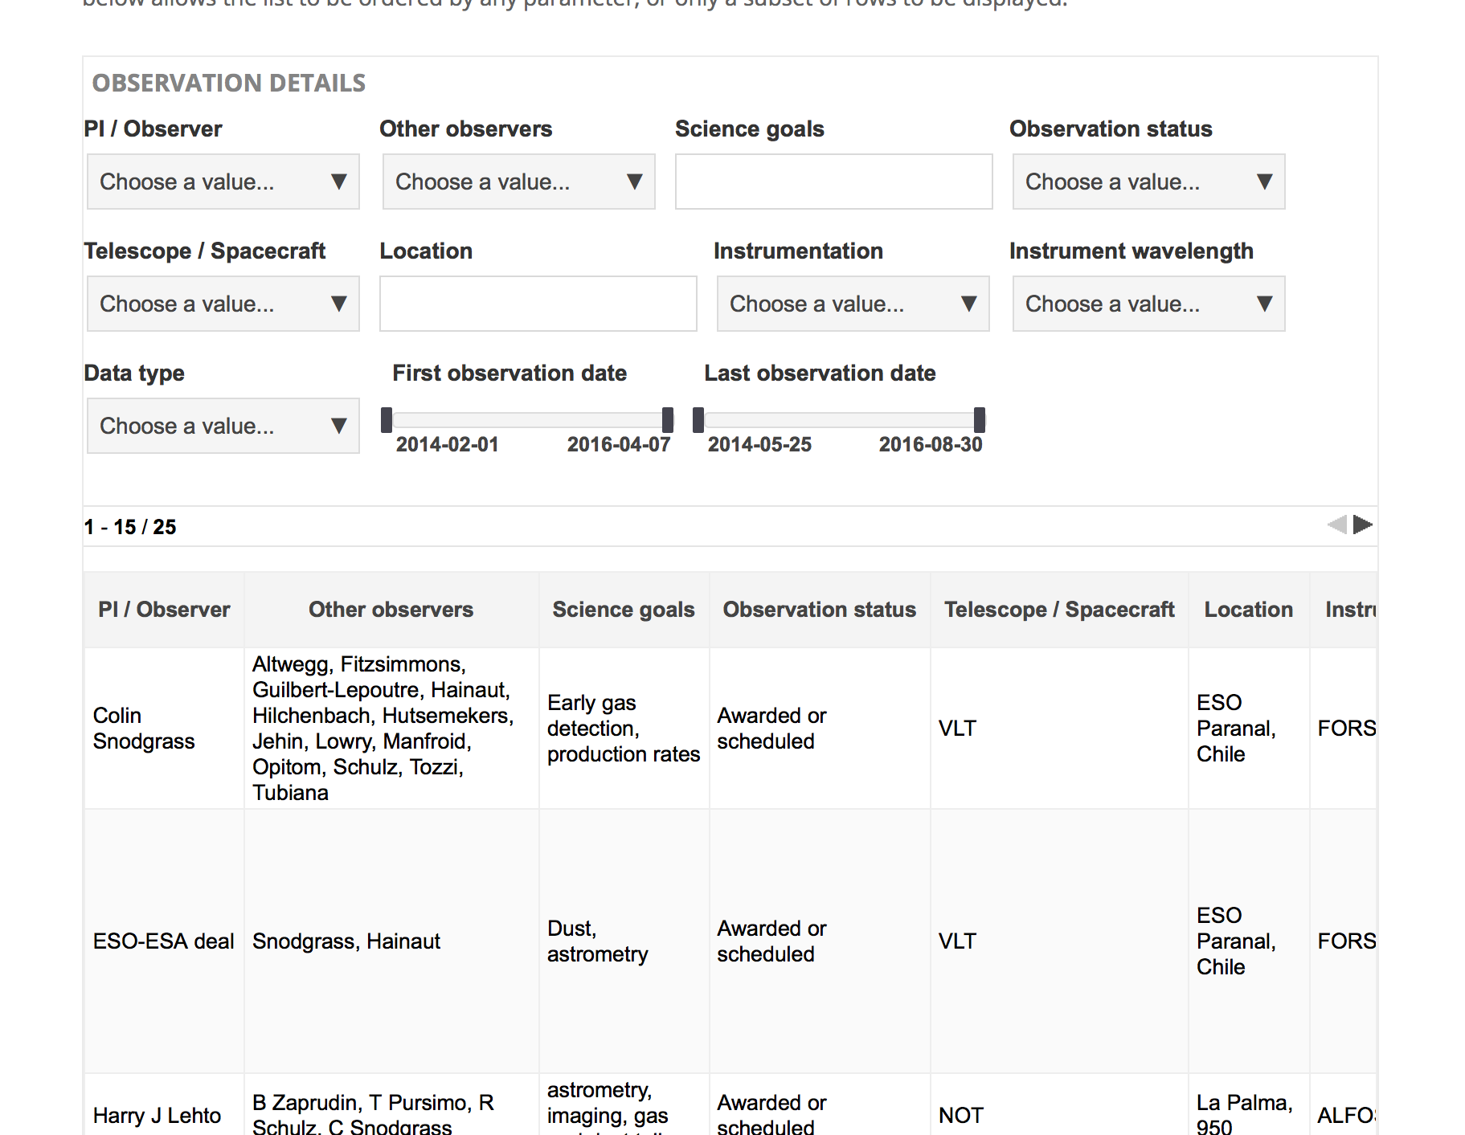
www.rosetta-campaign.net/planned-observations

Slide 19
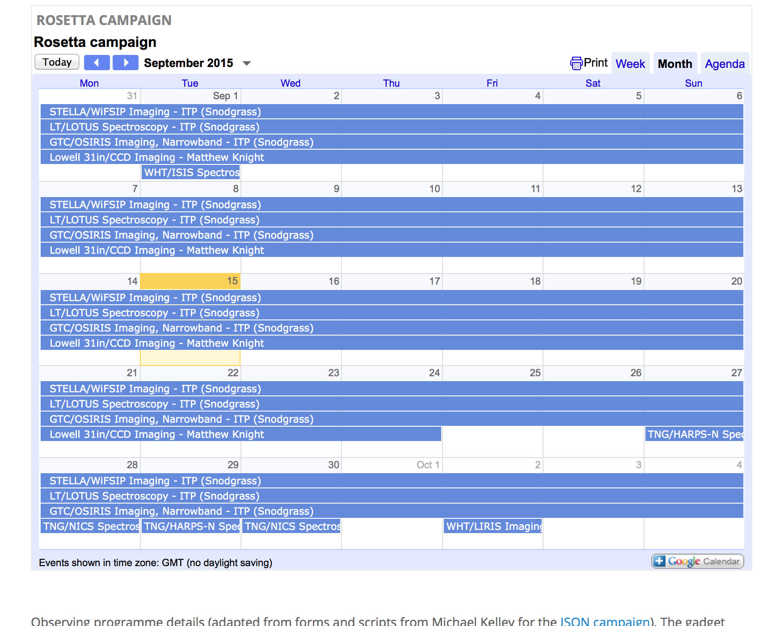
www.rosetta-campaign.net/planned-observations

Slide 20
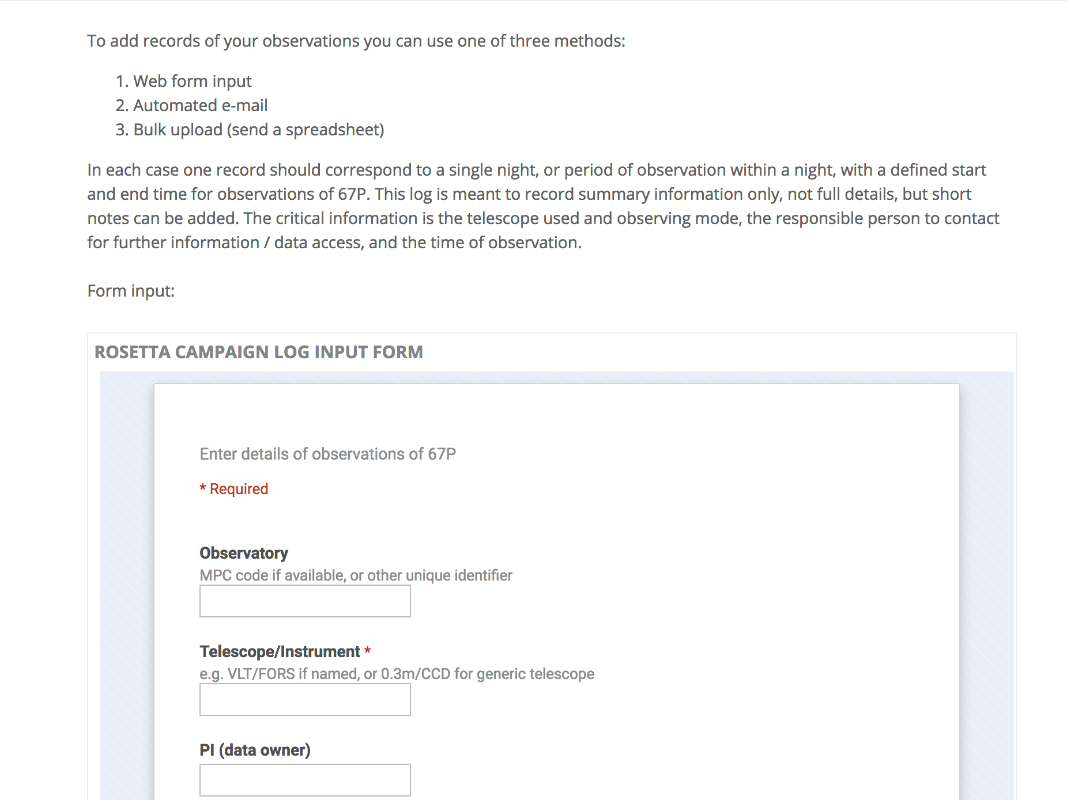

Slide 21
http://www.rosetta-campaign.net/observations

Slide 22
Log of observations
Systems set up on website for scriptable logging
Probably a bit late getting these running
Most people reported observations in a batch at the end, following some prompting
Would more real-time info have been useful?
In general people didn’t need that much info from each other
Latest brightness estimates useful, distributed from coordinator on request
Log more valuable later, in data analysis stage

Slide 23
Getting telescope time
Mixed approach:
Direct agreement with some observatories
Coordinated large proposals
Individual proposals from PIs interested in certain observations
ESO time through proposals, supported by ESO-ESA deal
opaque workings, but we got time
La Palma / Tenerife time through ITP
most telescopes (WHT, INT, TNG, GTC, LT, Stella) in one proposal
IRTF involved in discussions from start, specific line in CfP
In general, TACs gave us time anyway
Recognised unique opportunity, investment in mission

Slide 24
Archiving
Agreement that it is important to archive campaign data
Plan is to have it all archived with Rosetta data at ESA
ESA funding for PDRA to support this
It is progressing, but an annoying chore for people
Better to have planned this earlier, collected data as we went?
Or, people prefer to publish first, then send data?
Difficult, due to very varied data types and facilities
No consistency in FITS headers etc.

Slide 25
Lessons learned
Getting time not difficult with unique mission
Early planning for coordination valuable
Need to be aware of different telescope deadlines
Planning for data analysis and archiving could have been better
Automation of data logging would be good
I find some elements of website useful
not sure how much others used it (feedback form??)
Mailing list useful, primarily used for broadcast
Coordinator will spent a lot of time on this

Slide 26
Amateur observations

Slide 27
Amateur contributions
Amateur observations coordinated by Padma Yanamandra-Fisher
Her time paid by NASA Rosetta project for this
Website at JPL: http://rosetta.jpl.nasa.gov/rosetta-ground-based-campaign
FTP site set up at ESAC to collect data from amateurs
Most activity was through facebook group
In general, people keen to be involved, but mostly in discussing mission, sharing ‘pretty pictures’, rather than raw data collection

Slide 28
Lessons learned - FTP
FTP site was popular idea as ‘sending data to ESA’
However, wasn’t used very much
Observers weren’t encouraged to use it enough
Needed clearer instructions
Confusion about necessary formats and naming conventions may have put people off
Padma instead collected data via personal dropbox space, not very automatic
Eventually JPL intern sorted out data, sent it to me

Slide 29
Lessons learned - interactions
Very active facebook group
Padma’s preferred tool, but took a lot of her time
Good community, very engaged with mission in general (sharing news stories, images)
A bit exclusive
Some people don’t use FB
Padma was vetting each application to join group to keep out spammers etc.
Didn’t really address key goal of getting people to take and share data on comet (although some nice images)

Slide 30
Lessons learned – engaging people
Sign up form on JPL site, but little/no subsequent engagement with non-FB users
Mailing list might have been better?
Many existing communities in comet observation, various mailing lists in use
These groups active in following 67P/Rosetta
Keen comet observers, they would probably have observed it anyway…
Overlap with these advanced amateurs and core of FB group
Participation certificates were popular

Slide 31
Lessons learned – consistent data
Plan to distribute standard SDSS-type filters to suitable amateurs
i.e. those with right kit, experience, commitment
Would give consistent data sets
Was funded by NASA, but not acted on (too late to send filters by the time survey of what was needed was completed? Further delays in organisation?)

Slide 32
Lessons learned - summary
Engaging community through social media useful, but can miss people out
Not so effective at broadening pool of real data collectors
Effort needs to be made well in advance of campaign
Preparing observing guides, building community, assessing needs for any common equipment supply, having people used to systems and ready to submit data

Slide 33
backup

Slide 34
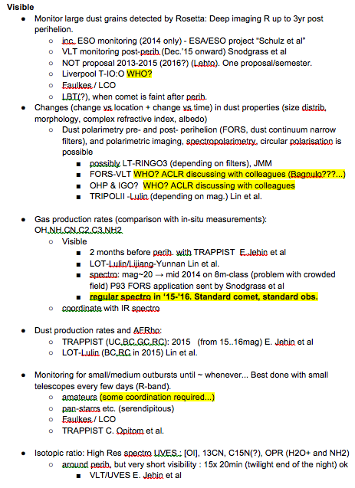
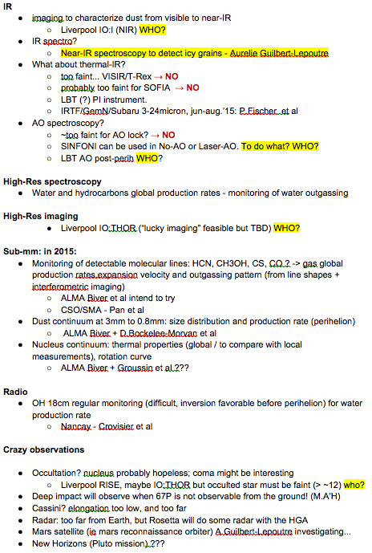
Wish list

Slide 35
Observations pre-Rosetta
Observations since CG selected in 2002
Large telescope images of inactive nucleus: size, shape, spin period, pole
Multiple apparition coma monitoring: jets, dust properties, pole, activity cycle
Thermal IR (Spitzer, Herschel): nucleus and dust coma properties
Monitoring up to 2013 (mostly with VLT) for astrometry and total activity (helpful for mission planning)
Not part of coordinated campaign.
Individual proposals from various teams

Slide 36
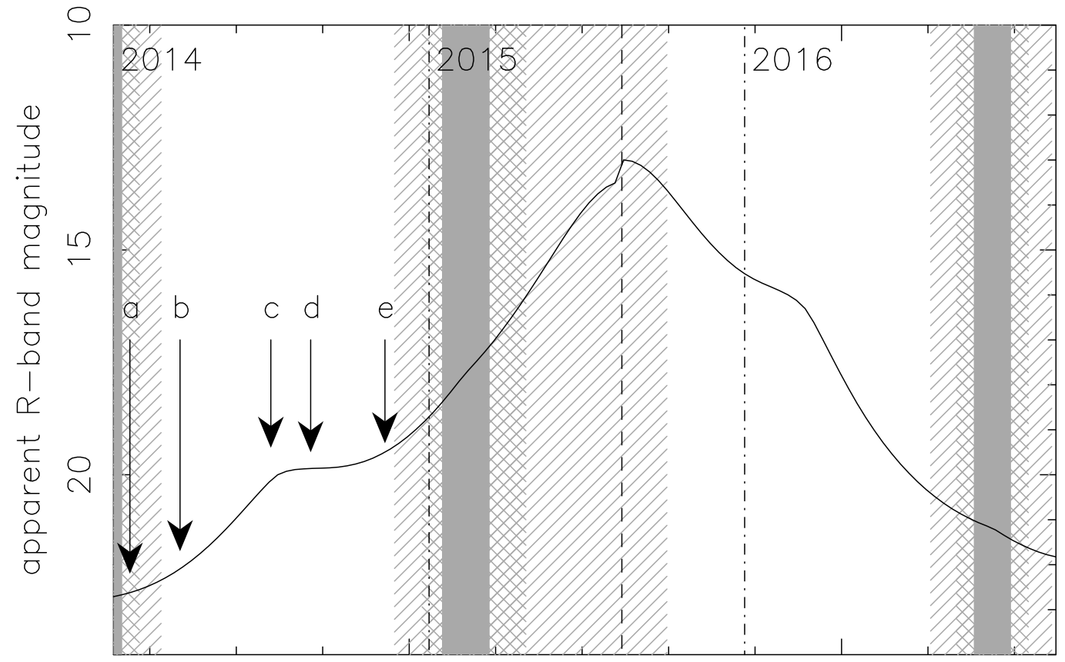
Visibility
Snodgrass et al 2013 model is used to predict brightness in next years
Peak around R~13 at perihelion
Within ρ=10,000 km aperture
Observability:
Southern hemisphere (and crowded field) in 2014
Close to Sun until after perihelion
Then in Northern sky

